Slide 1

Hong Kong Trade Development Council
UAT Training – Fixed Assets
27 AUG 2020

Slide 2

Agenda
Asset Additions
Process Mass Additions from AP
Merge Mass Additions
Split Mass Additions
Add Mass Additions from AP to Existing Asset
Upload Mass Additions by WebADI
Post Mass Additions
Delete Mass Additions
Print Asset Barcode
Month-end Process
Run Depreciation
Create Accounting
Q&A

Slide 3
Asset Additions
Process Mass Additions from AP

Slide 4
Mass Addition Process

Slide 5
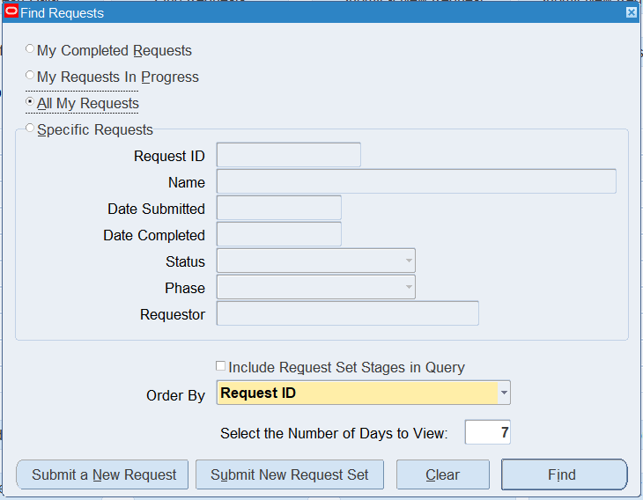
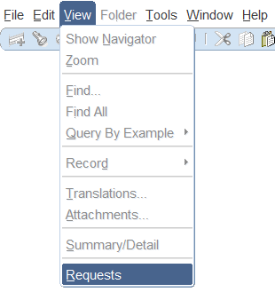
Asset Additions
Process Mass Additions from AP (1/12)
Responsibility:
TDC Fixed Asset Operator/
TDC Fixed Asset Superuser
Choose “Requests” function.
(Menu) View > Requests
Click “Submit New Request Set.
Note: Only AP invoices charging to Asset Clearing nature code and posted
to GL will be transferred to FA. Each
invoice distribution will become one single mass addition line.
1
2

Slide 6
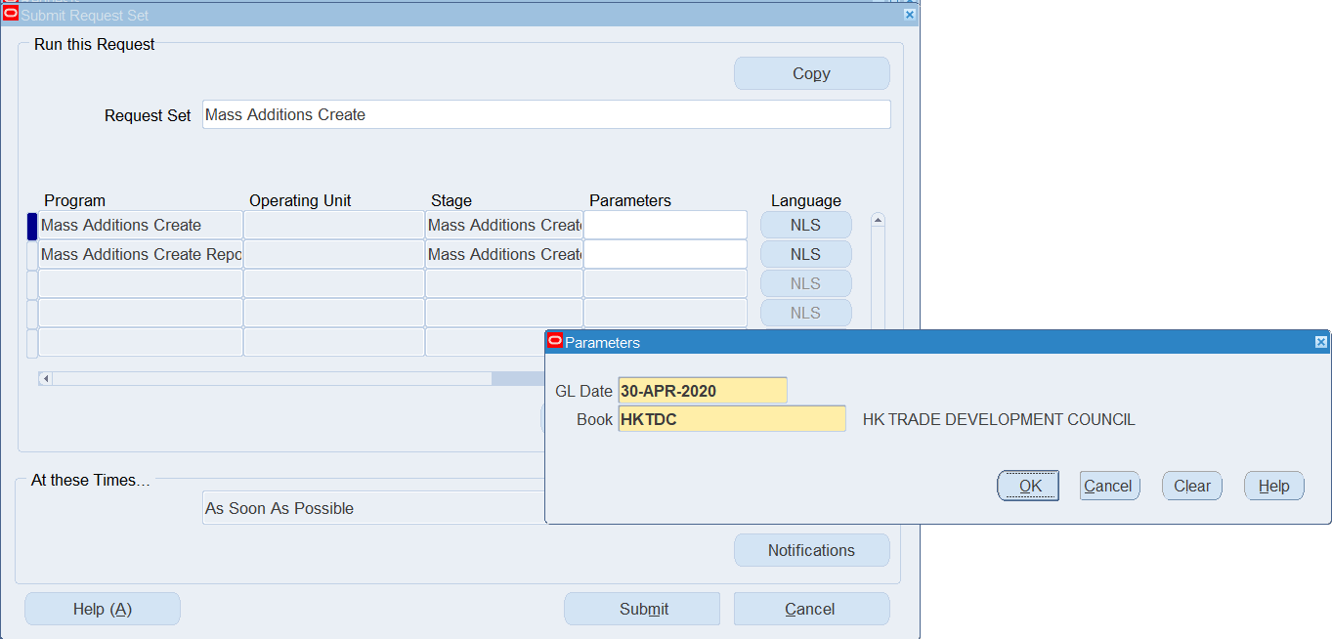
Asset Additions
Process Mass Additions from AP (2/12)
Select the “Mass Additions Create” request set to transfer the invoice distribution lines from AP to FA.
Click on the Parameters field.
Enter the last GL Date. Invoice distribution lines with GL date before the entered date will be transferred from AP to FA. You should select a date before the last date of the current FA period.
Select the “HKTDC” Book.
Click “OK”.
Click “Submit”.
3
4
5
6
7
8

Slide 7
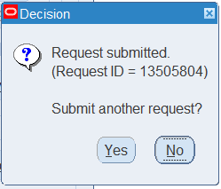
Asset Additions
Process Mass Additions from AP (3/12)
Click “No” for only submitting this request.
Click “Find”.
9
10

Slide 8
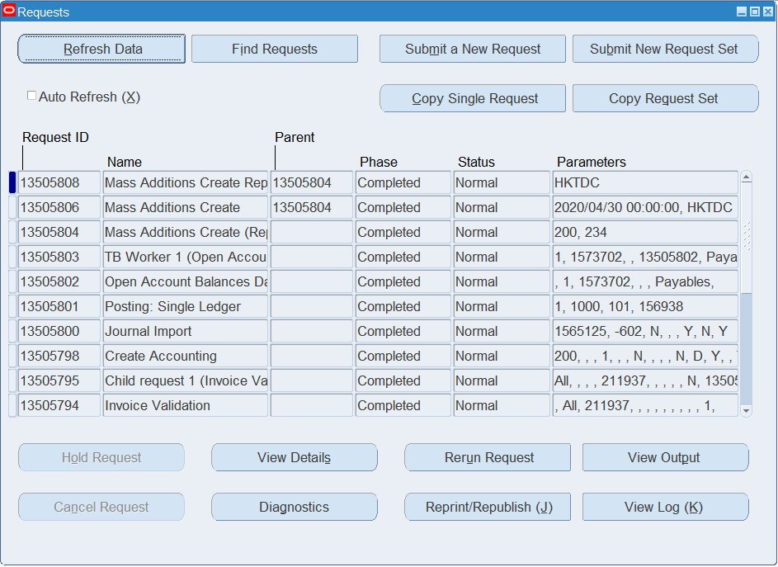
Asset Additions
Process Mass Additions from AP (4/12)
Click “Refresh Data” until the Mass Additions Create Report request completes normally.
Select the Mass Additions Create Report.
Click “View Output”
11
12
13

Slide 9
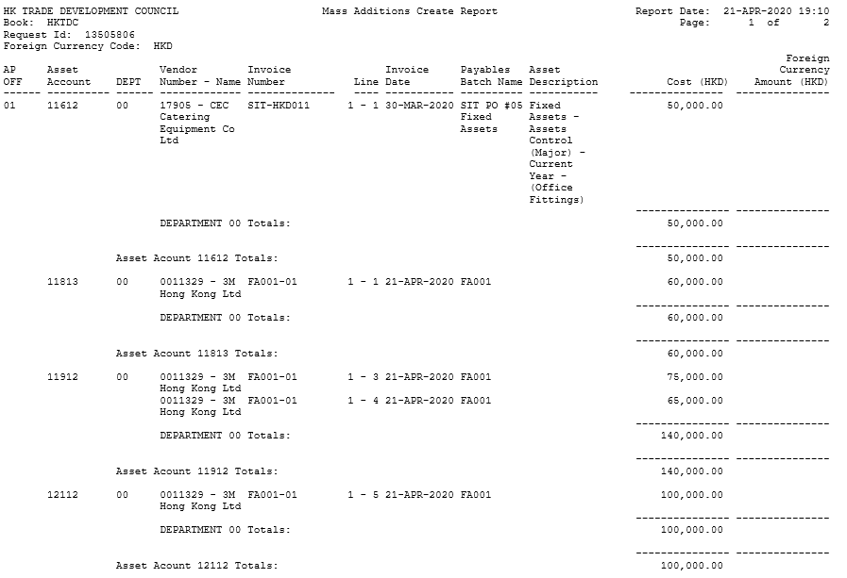
Asset Additions
Process Mass Additions from AP (5/12)
Review the Mass Additions Create Report to review mass addition lines just transferred from AP.

Slide 10
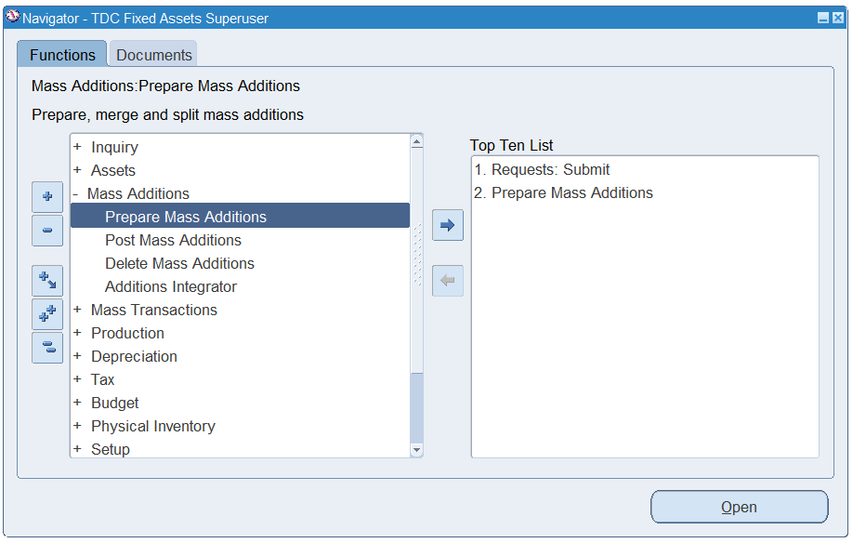
Asset Additions
Process Mass Additions from AP (6/12)
FA - (N) > Mass Additions > Prepare Mass Additions.
15

Slide 11
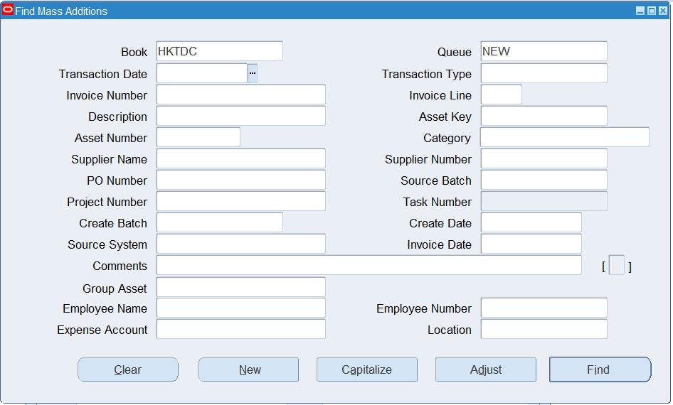
Asset Additions
Process Mass Additions from AP (7/12)
Enter any search criteria to search for the mass addition lines.
Click “Find”.
16
17

Slide 12
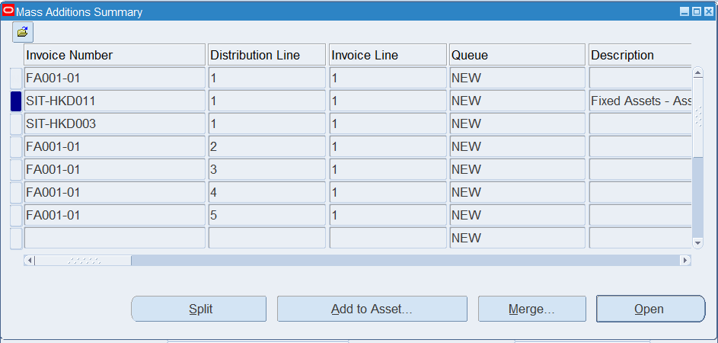
Asset Additions
Process Mass Additions from AP (8/12)
Select a mass addition line.
Click “Open”.
18
19

Slide 13
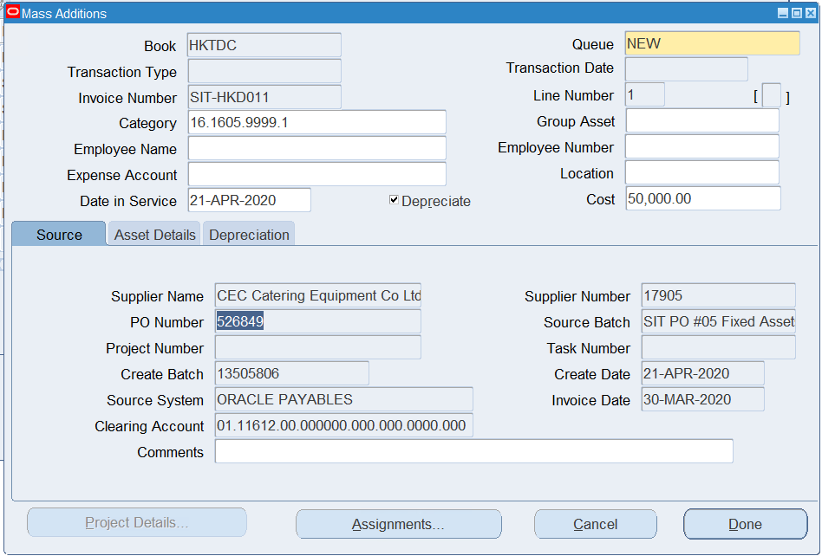
Asset Additions
Process Mass Additions from AP (9/12)
20
Update the Queue name if appropriate.
POST: Mass addition line ready to be posted
ON HOLD: Mass addition line updated or put on hold by user
DELETE: Mass addition line to be deleted
Enter the Asset Category, Date In Service, Cost and Descriptive Flexfield [ ] if appropriate. Note: If user overwrites the asset cost, the user must make sure the total cost of the same asset clearing account must be same as the corresponding invoice distribution lines.
21

Slide 14
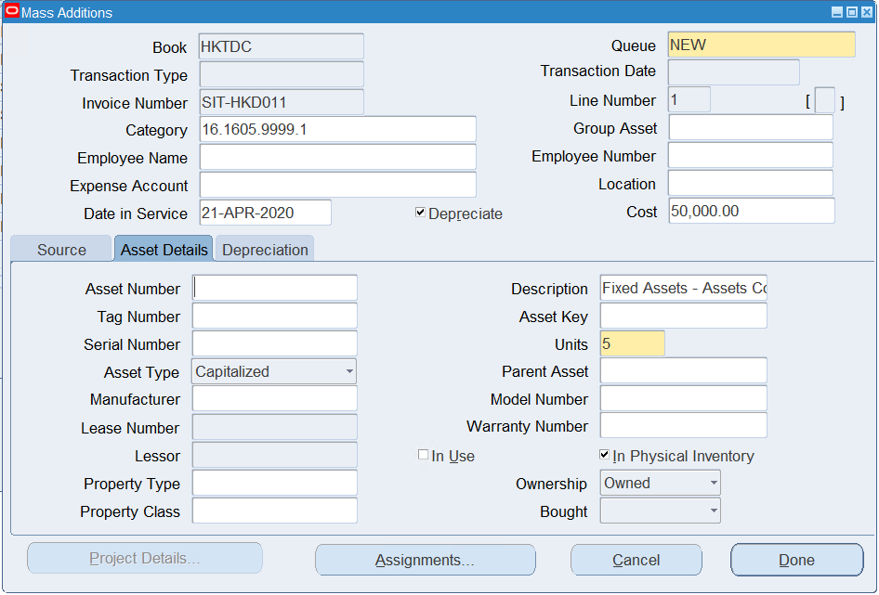
Asset Additions
Process Mass Additions from AP (10/12)
Click the “Asset Details” tab.
Optionally enter an Asset Number. If it is left blank, an asset number will be automatically generated by the system.
Update the Description. The default asset description comes from the invoice distribution description if entered.
Enter other asset information if required.
22
23
24
25

Slide 15
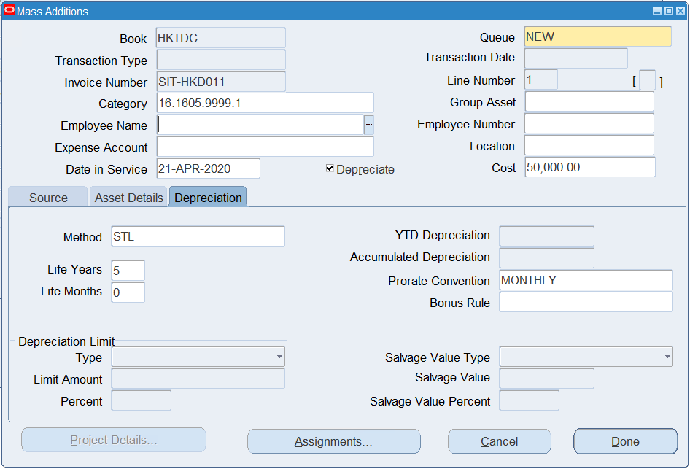
Asset Additions
Process Mass Additions from AP (11/12)
Click the “Depreciation” tab.
Update the Life Years and Months to change the useful life used to calculated the depreciation expense.
Click the “Assignments” button.
26
27
28

Slide 16
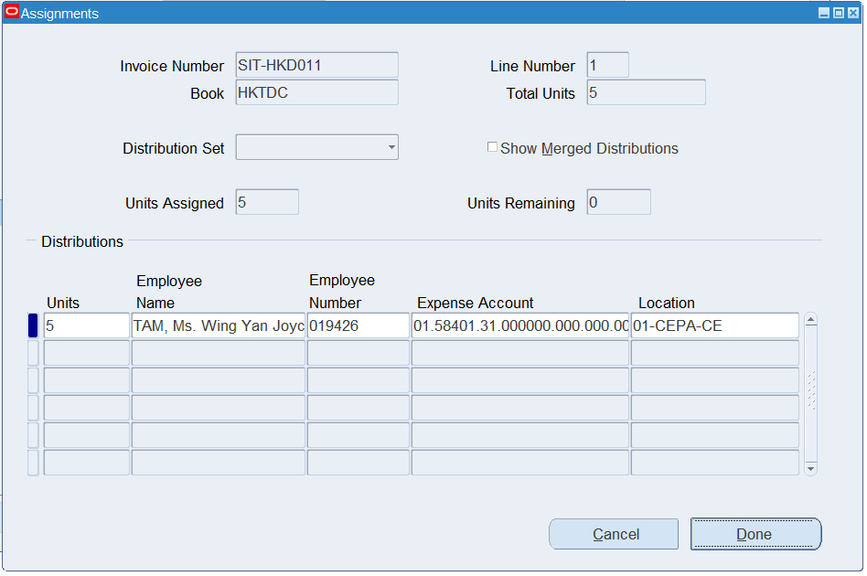
Asset Additions
Process Mass Additions from AP (12/12)
Update the Unit, Employee Name/Number (optional), Expense Account and Location of the existing assignment if appropriate. The PR requester name will be the default value for the employee name.
Click to add more assignments if required. Make sure the total units of all assignments equal to the unit of the asset.
Click “Done” to save. The Queue name will be changed to “ON HOLD” automatically if it is not updated manually.
29
31

Slide 17
Asset Additions
Merge Mass Additions

Slide 18
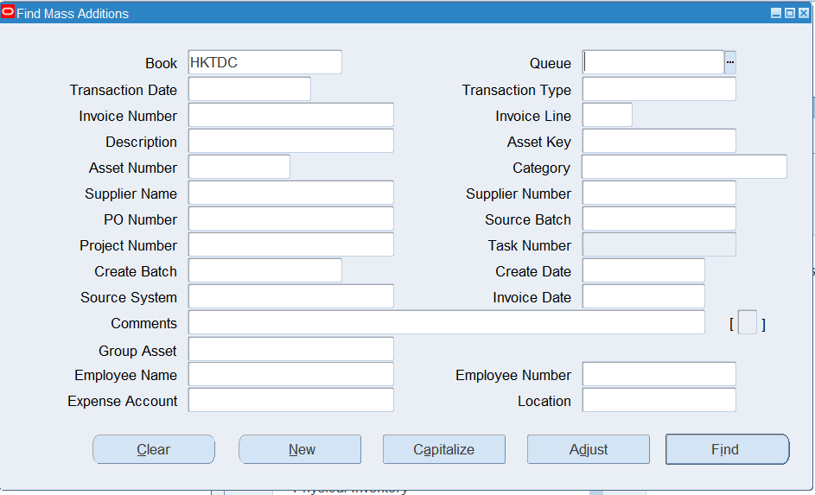
Asset Additions
Merge Mass Additions (1/4)
Responsibility:
TDC Fixed Asset Operator/
TDC Fixed Asset Superuser
If you would like to merge multiple mass addition lines to become one single asset, follow the steps in this section.
FA - (N) > Mass Additions > Prepare Mass Additions.
Enter any search criteria to search for the mass addition lines.
Click “Find”.
2
3

Slide 19
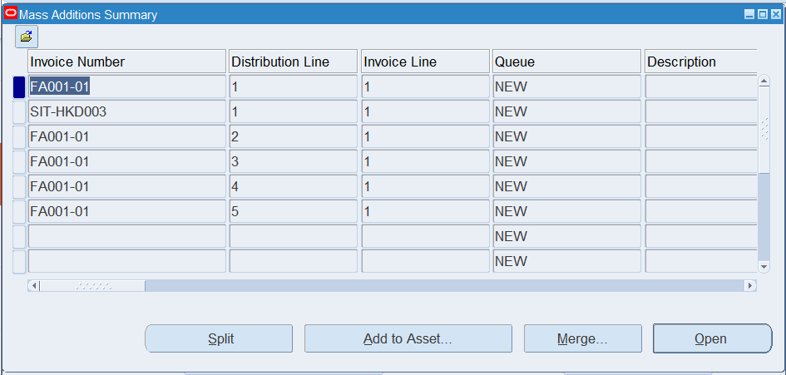
Asset Additions
Merge Mass Additions (2/4)
Select a mass addition line.
Click “Merge”.
3
4

Slide 20
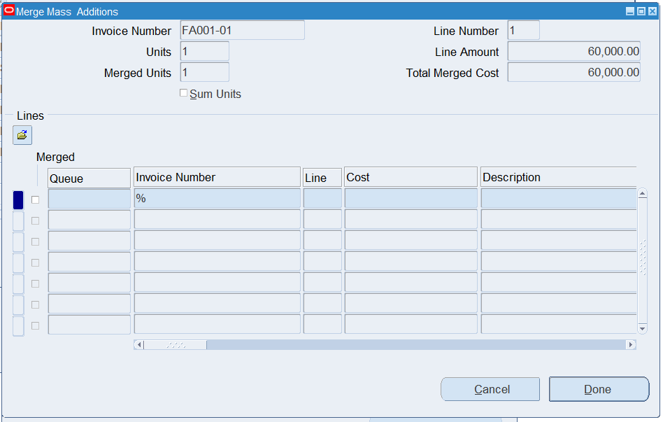
Asset Additions
Merge Mass Additions (3/4)
Press F11 to enter query mode.
Enter the criteria to search for the mass addition lines to be merged into this line. Alternatively, enter “%” in the Invoice Number field to show all lines.
Press F11 to perform the query.
Note:
Only unmerged and unposted mass addition lines can be merged into another line.
6

Slide 21
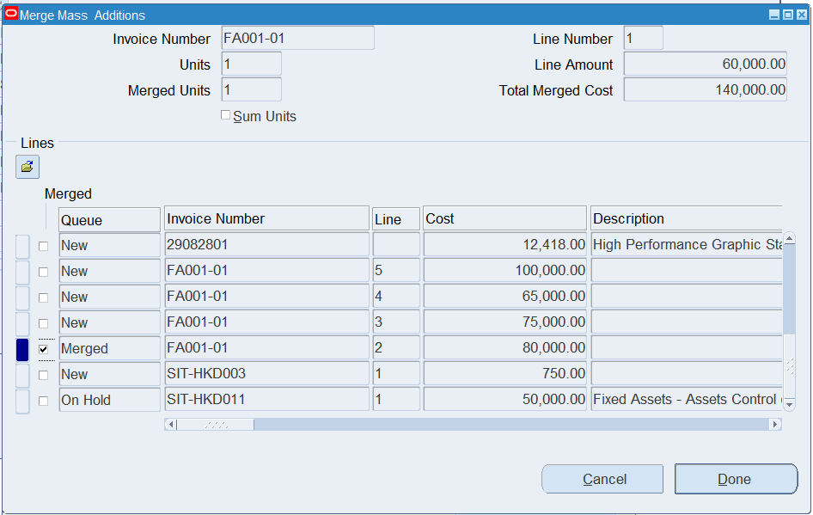
Asset Additions
Merge the Mass Additions (4/4)
All mass addition lines matching the search criteria will be shown.
Check the Merged checkbox to merge the selected mass addition line.
Uncheck the Merged checkbox to unmerged the selected line
Click “Done” when finish merging all the lines.
Note: The assignments (depreciation expense accounts & locations) of the merged lines will NOT be added to the parent asset. Manually update the assignments of the asset if appropriate.
8
9

Slide 22
Asset Additions
Split Mass Additions

Slide 23
Asset Additions
Split Mass Additions (1/12)
Responsibility:
TDC Fixed Asset Operator/
TDC Fixed Asset Superuser
If you would like to split a mass addition line into multiple line by the number of units, follow the steps in this section.
FA - (N) > Mass Additions > Prepare Mass Additions.
Enter any search criteria to search for the mass addition lines.
Click “Find”.
2
3

Slide 24
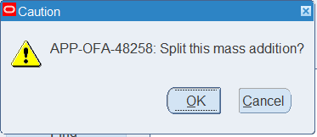
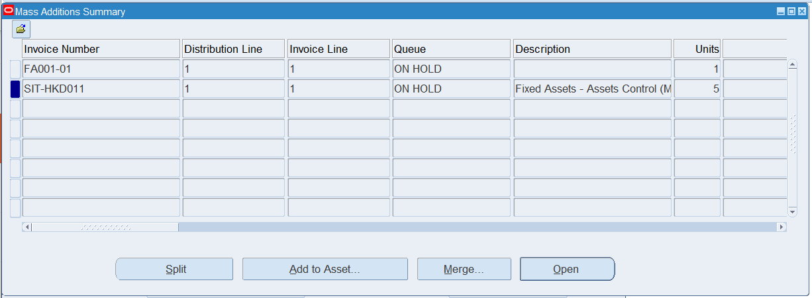
Asset Additions
Split Mass Additions (2/3)
Select a multiple-unit mass addition line. Note: Unit are copied from PO-matched invoices only and the unit invoiced must be an integer. Otherwise, Oracle defaults an unit = 1 to the mass addition line.
Click “Split”.
Click “OK” to confirm splitting the mass addition line.
6
4
5

Slide 25
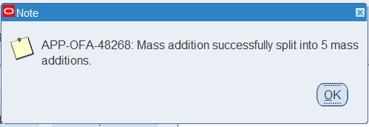
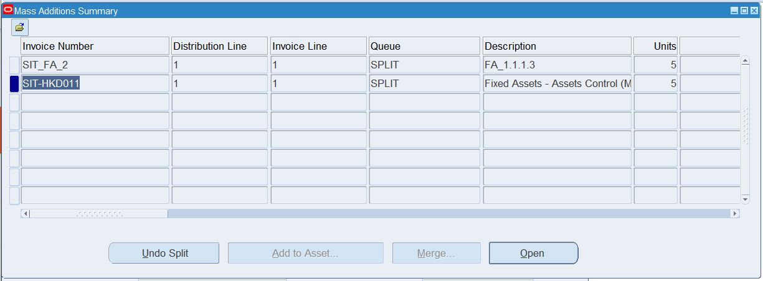
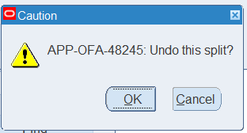
Asset Additions
Split Mass Addition (3/3)
A pop up will be shown to confirm that the mass addition line was split. Click “OK” to acknowledge.
To unsplit a mass addition line, query the mass addition line in “SPLIT” queue.
Click “Undo Split”.
Click “OK” to confirm to undo the split.
7
8
10
9

Slide 26
Asset Additions
Add Mass Addition Lines to Existing Asset

Slide 27
Asset Additions
Add Mass Addition Lines to Existing Asset (1/12)
Responsibility:
TDC Fixed Assets Operator
TDC Fixed Assets Superuser
If you would like to add a mass addition line to an existing asset in the asset register to increase the cost of the asset, follow the steps in this section.
FA - (N) > Mass Additions > Prepare Mass Additions.
Enter any search criteria to search for the mass addition lines.
Click “Find”.
Note: Lines in POST queue cannot be added to an existing asset
2
3

Slide 28
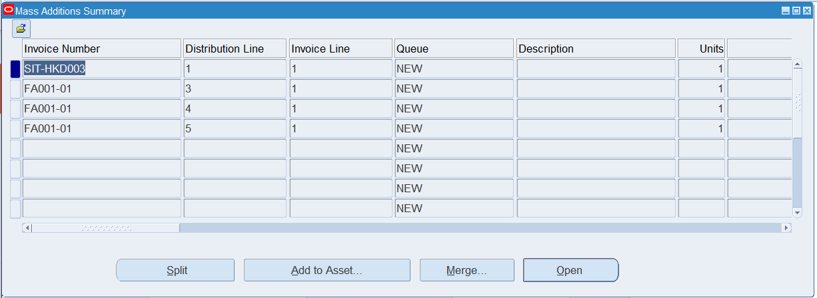
Asset Additions
Add Mass Addition Lines to Existing Asset (2/6)
Select a mass addition line.
Click “Add to Asset”.
4
5

Slide 29
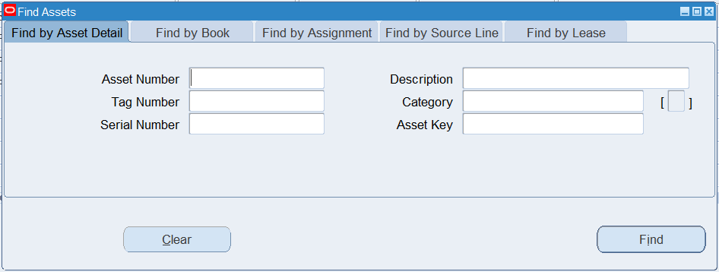
Asset Additions
Add Mass Addition Lines to Existing Asset (3/6)
Enter the search criteria to find the asset to which the mass addition line will be added.
Click “Find”.
6
7

Slide 30
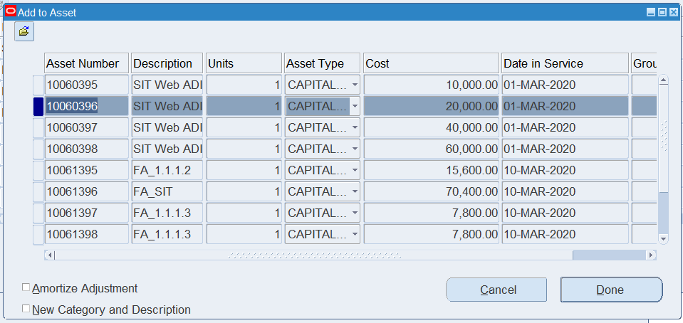
Asset Additions
Add Mass Addition Lines to Existing Asset (4/6)
Select the asset to which the mass addition line will be added.
Optionally check the “Amortize Adjustment” checkbox to start calculating the depreciation expense in the current period by dividing new net book value of the asset by the remaining of the asset.
Optionally check the “New Category and Description” checkbox to change the category and description of the existing asset to those of the mass addition line.
Click “Done” to confirm.
8
11
9
10

Slide 31
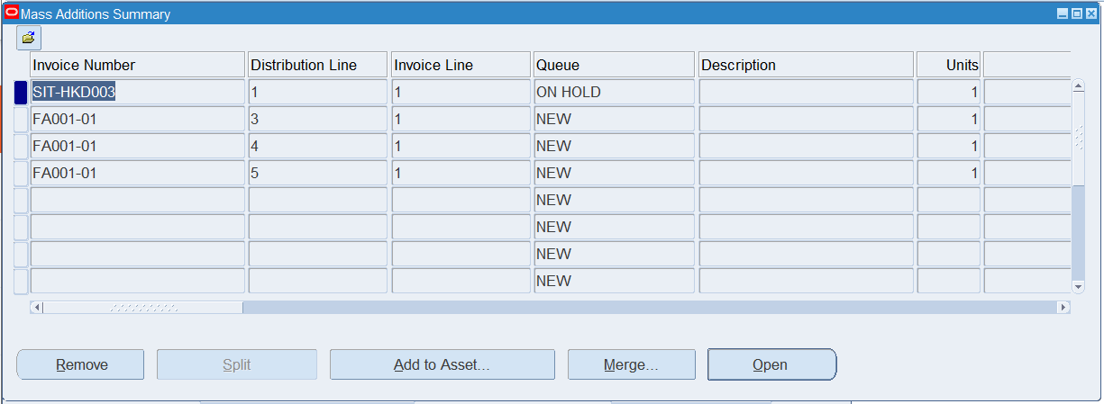
Asset Additions
Add Mass Addition Lines to Existing Asset (5/6)
The “Add to Asset” action can be undone by clicking the “Remove” button.
To post “Add to Asset” action to the asset register, click “Open”.
13
12

Slide 32
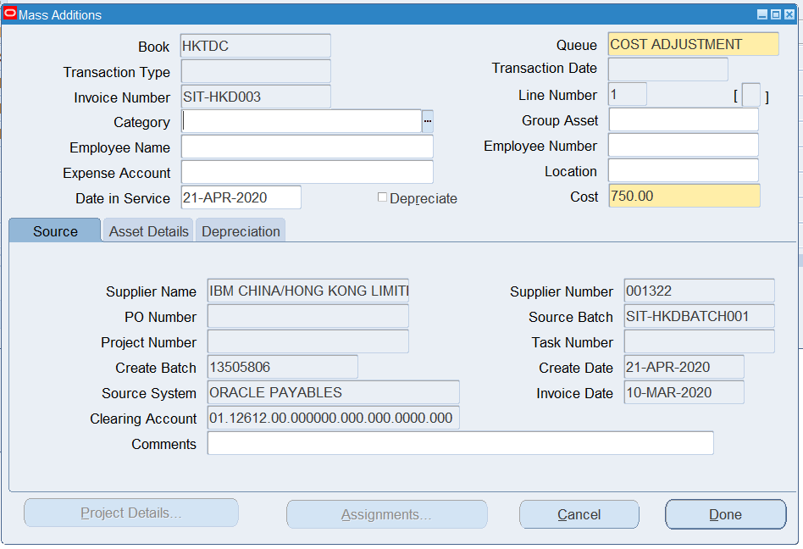
Asset Additions
Add Mass Addition Lines to Existing Asset (6/6)
Update the Queue to “POST” to mark this line as ready to be posted. System automatically changes the Queue to “COST ADJUSTMENT” to identify that this mass addition line will be added to an existing asset.
Click “Done” to save.
14
15

Slide 33
Asset Additions
Upload Mass Additions by WebADI

Slide 34
Asset Additions
Upload Mass Additions by WebADI (1/12)
Responsibility:
TDC Fixed Asset Operator/
TDC Fixed Asset Superuser
FA - (N) > Mass Additions > Additions Integrator
Note: Assets uploaded through WebADI can have one assignment and one source line only
1

Slide 35
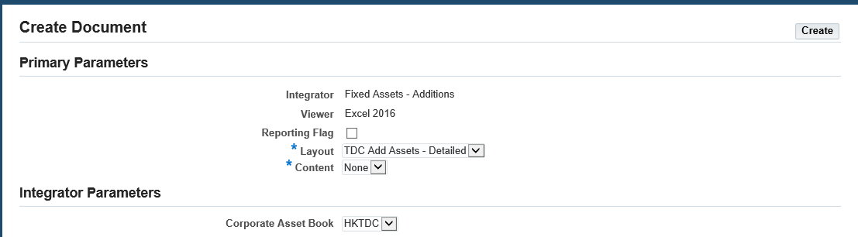
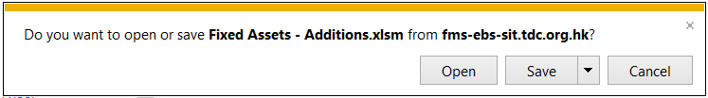
Asset Additions
Upload Mass Additions by WebADI (2/12)
Select the “TDC Add Assets – Detailed” layout.
Click “Create”.
Save the Excel file generated to your PC.
3
2
4

Slide 36
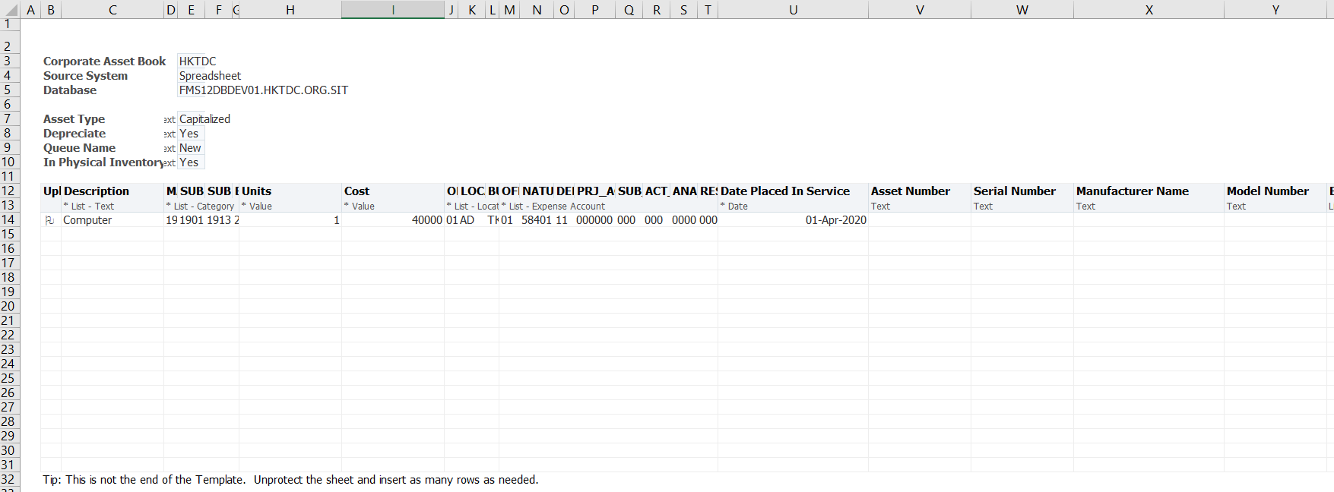
Asset Additions
Upload Mass Additions by WebADI (3/12)
Open the Excel File downloaded with Macro enabled.
Select whether the assets will be depreciated.
Select the Mass Addition Queue Name:
NEW: New mass addition line
POST: Mass addition line ready to be posted
ON HOLD: Mass addition line updated or put on hold by user
DELETE: Mass addition line to be deleted
6
7

Slide 37
Asset Additions
Upload Mass Additions by WebADI (4/12)
Double click on column B to flag or unflag a row for uploading.
Enter the asset details. If the field has list of values attached to it, double click on the field to see the available values. Mandatory fields are marked with an asterisk (*).
Enter the Asset Description.
9
8
10

Slide 38

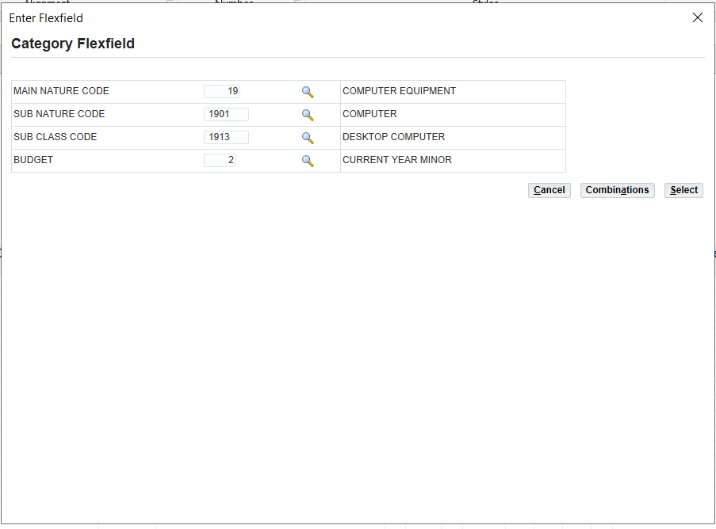
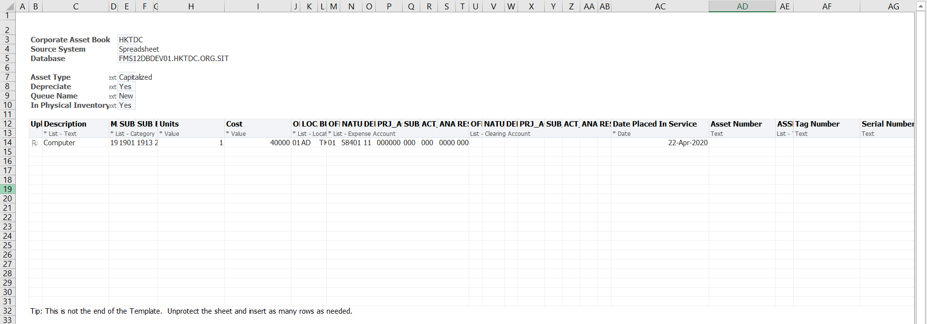
Asset Additions
Upload Mass Additions by WebADI (5/12)
Select the Asset Category. Double click on the field to open the List of Values.
Enter the value for each segment.
Click on the icon to show the possible values of each segment.
Click “Combinations” to show the possible combinations based on the segment values selected
Click “Select” to validate and fill in the entered combination.
12
13
14
15
11

Slide 39
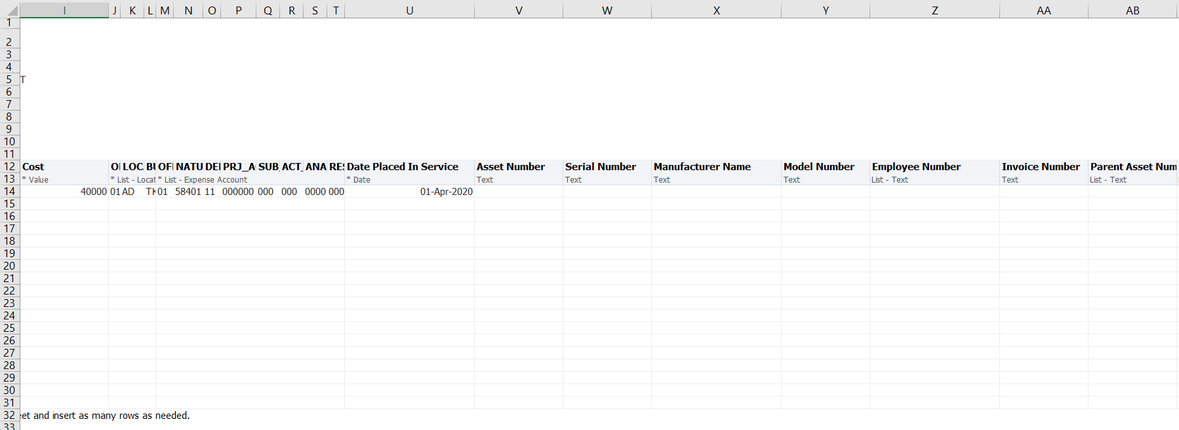
Asset Additions
Upload Mass Additions by WebADI (6/12)
Scroll to the right to see more columns in the WebADI template.
Enter the Asset Cost.
Select the Asset Location.
Select the Depreciation Expense account.
Enter the asset date placed in service. System will start depreciating the asset from the entered date and catch-up any missed depreciation expense in the current period.
Optionally enter an Asset Number. If it is left blank, an asset number will be automatically generated by the system.
Optionally enter the Serial Number.
Optionally enter the Manufacturer and Model of this new asset.
Optionally select the employee to which this asset is assigned.
16
17
18
19
20
21
22
23
24

Slide 40
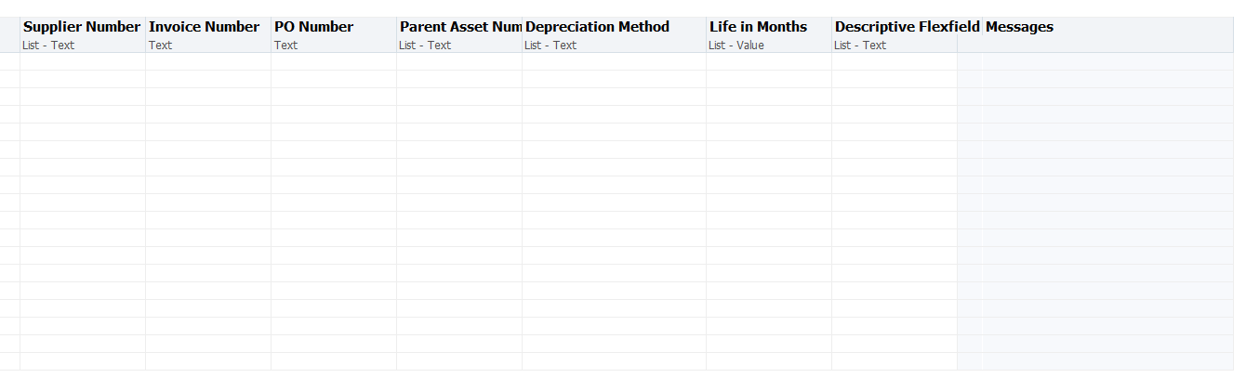
Asset Additions
Upload Mass Additions by WebADI (7/12)
Scroll to the right to see more columns in the WebADI template.
Optionally enter the Supplier Number, Invoice Number and PO Number related to this new asset.
Optionally select a Parent Asset of this new asset.
Optionally select “STL” as the Depreciation Method and enter a Life in Months to override the default useful life from the selected asset category.
Double click on the Descriptive Flexfield column and enter the Descriptive Flexfields.
24
27
28
29

Slide 41
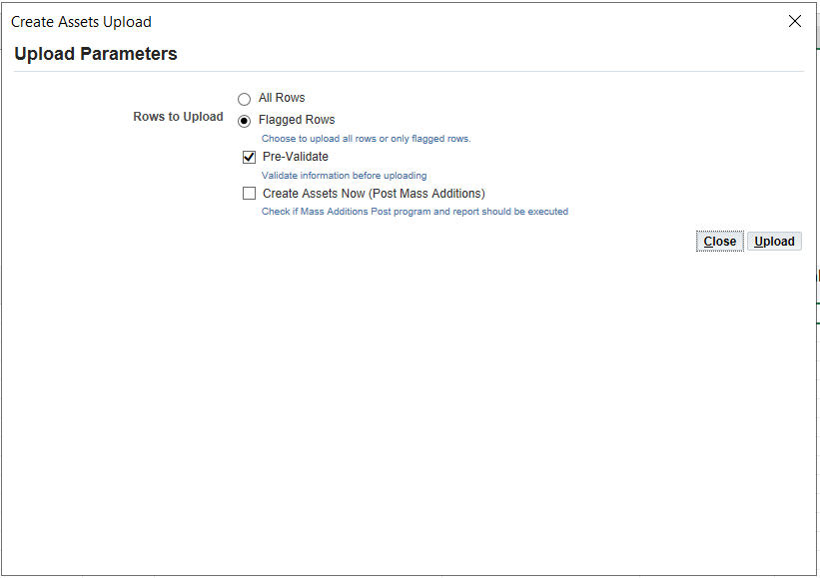
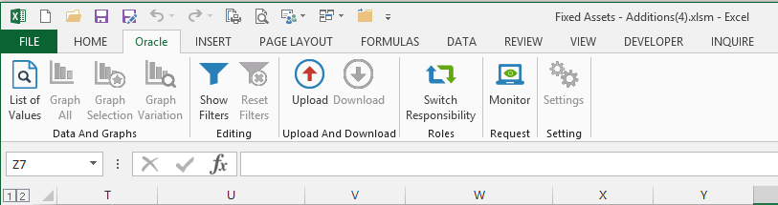
Asset Additions
Upload Mass Additions by WebADI (8/12)
On the Excel menu, select the Oracle tab.
Click “Upload”.
Select whether to upload all or only the flagged rows.
Select whether to run the “Post Mass Additions” request to post the asset immediately.
Click “Upload”.
30
32
33
31
34

Slide 42
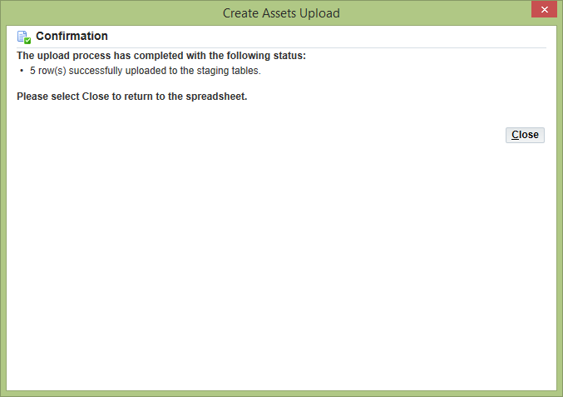
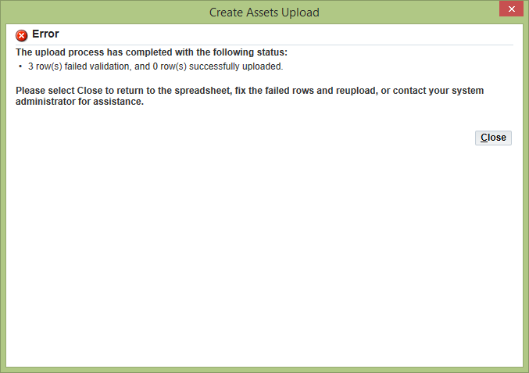
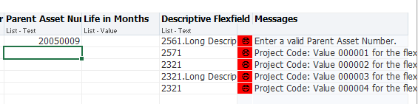
Asset Additions
Upload Mass Additions by WebADI (9/12)
Wait until the upload process is completed.
Click “Close”.
If there is any row with error, refer to the Messages column for the error messages. Fix the issue and re-uploaded the records.
35
36
37

Slide 43
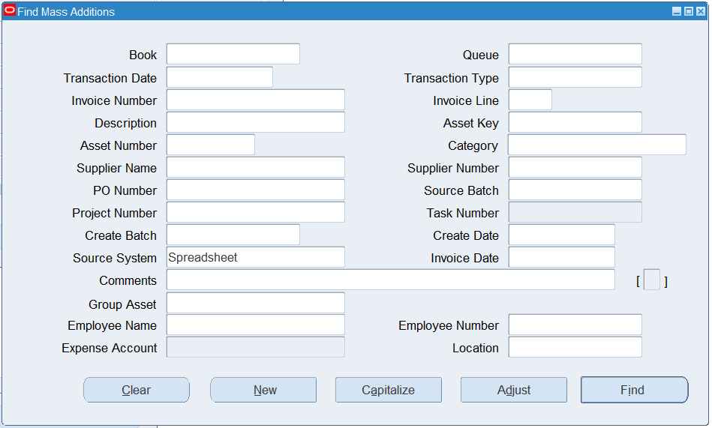
Asset Additions
Upload Mass Additions by WebADI (10/12)
FA - (N) > Mass Additions > Prepare Mass Additions
In the Find Mass Additions window, specify “Spreadsheet” for the Source System to find mass addition lines uploaded from WebADI.
Click “Find”.
39
40

Slide 44
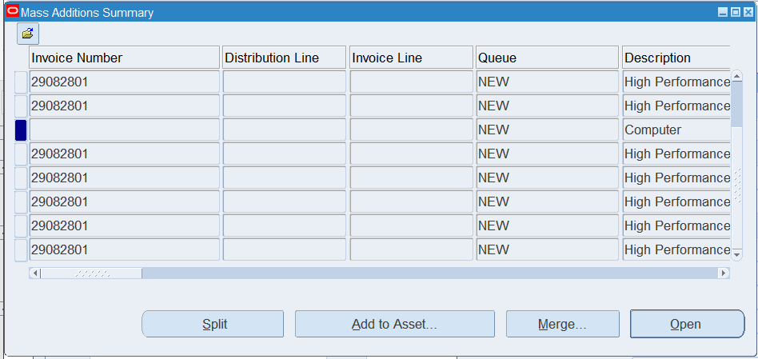
Asset Additions
Upload Mass Additions by WebADI (11/12)
Select a mass addition line.
Click “Open”.
41
42

Slide 45
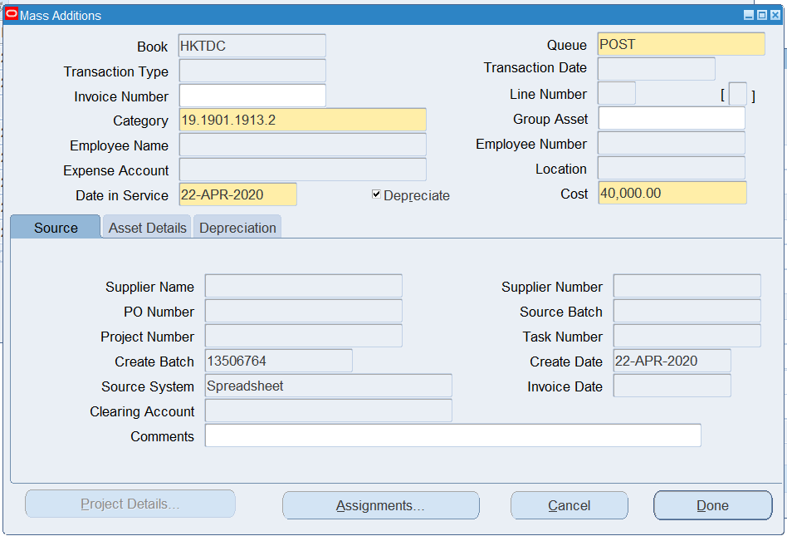
Asset Additions
Upload Mass Additions by WebADI (12/12)
Review details of the mass addition lines uploaded.
Update the Queue to “POST” after confirming the mass addition line details.
Click “Done” to save.
Note: The mass addition line will become an asset in the asset register only after the post mass addition process.
44
43
45

Slide 46
Asset Additions
Post Mass Additions

Slide 47
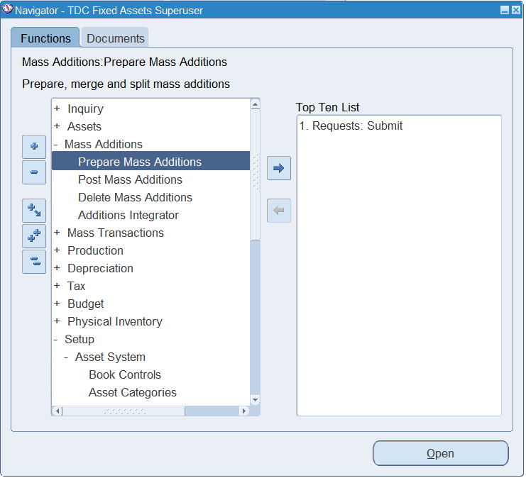
Asset Additions
Post Mass Additions (1/5)
Responsibility:
TDC Fixed Asset Superuser
FA - (N) > Mass Additions > Post Mass Additions
1

Slide 48
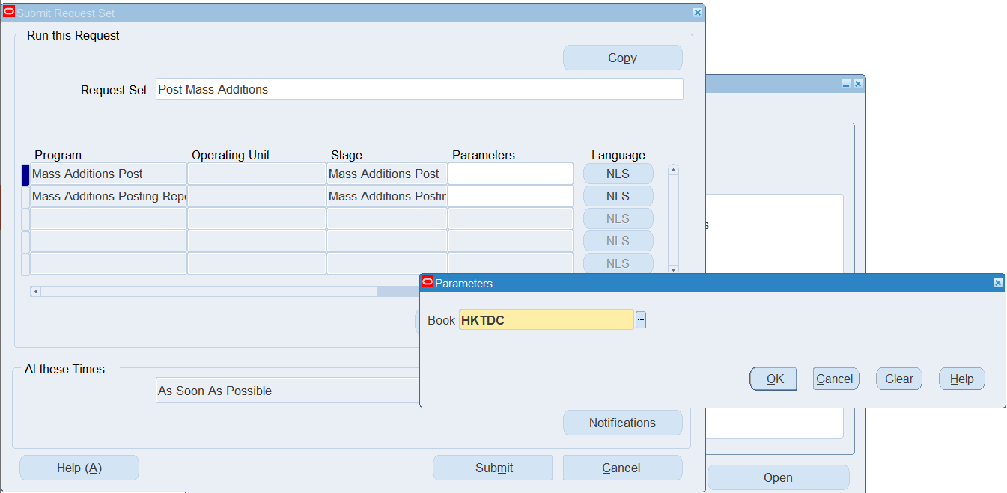
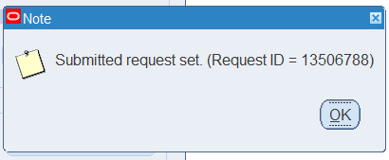
Asset Additions
Post Mass Additions (2/5)
Click on the Parameters field.
Select the “HKTDC” Book.
Click “OK”.
Click “Submit”.
Click “OK”.
2
6
3
4
5

Slide 49
Asset Additions
Post Mass Additions (3/5)
Choose “Requests” function. (Menu) View > Requests
Click “Find”.
7
8

Slide 50
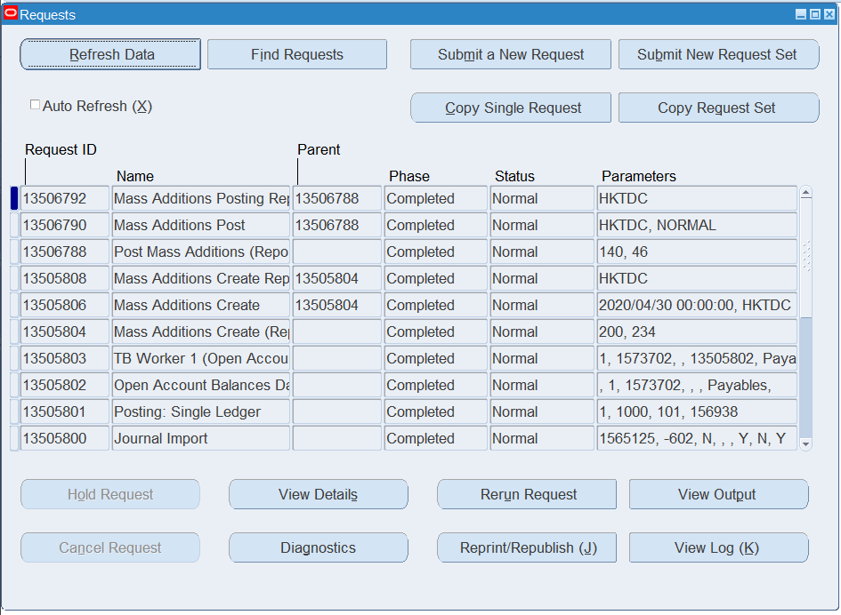
Asset Additions
Post Mass Additions (4/5)
Click “Refresh Data” until the Mass Additions Posting Report request completes normally.
Select the Mass Additions Posting Report.
Click “View Output”
9
10
11

Slide 51
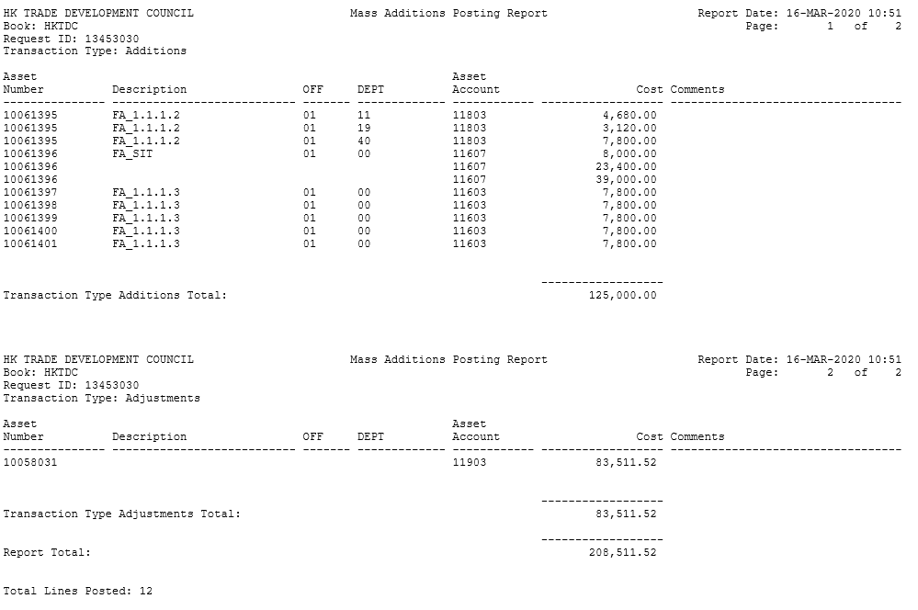
Asset Additions
Post Mass Additions (5/5)
The mass addition lines posted to the fixed asset register will be shown for review.

Slide 52
Asset Additions
Delete Mass Additions

Slide 53
Asset Additions
Delete Mass Additions (1/4)
Responsibility:
TDC Fixed Asset Operator/
TDC Fixed Asset Superuser
If you would like to delete mass addition lines in the Queue “Delete” or those already posted to the fixed asset register, following the steps in this section.
FA - (N) > Mass Additions > Delete Mass Additions
Note: Deleted mass addition lines cannot be recovered.
1

Slide 54
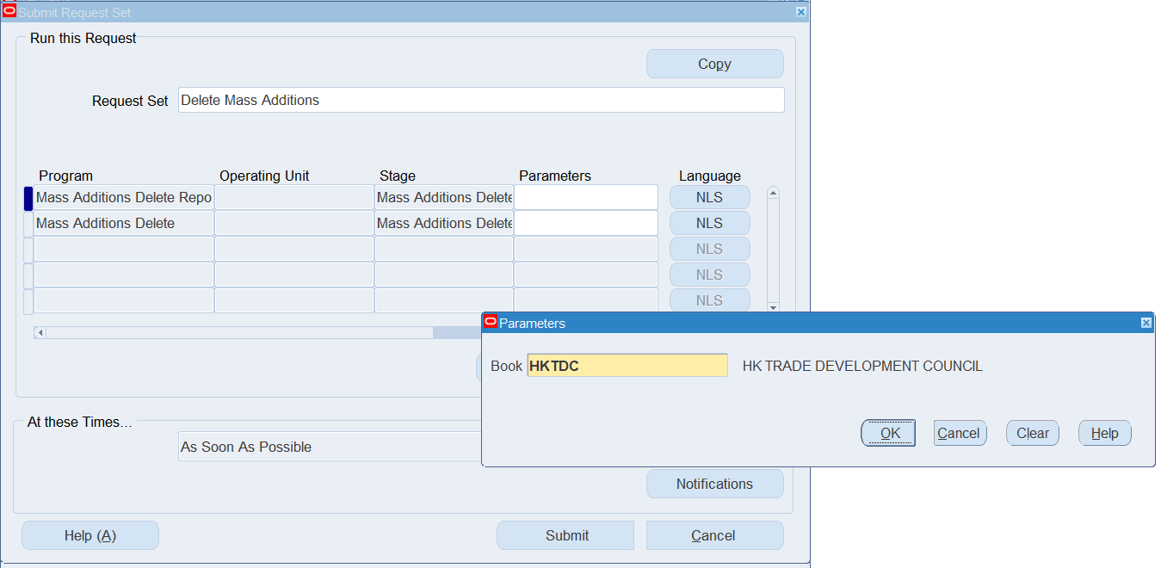
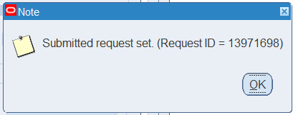
Asset Additions
Delete Mass Additions (2/6)
Click on the Parameters field.
Select the “HKTDC” Book.
Click “OK”.
Click “Submit”.
Click “OK”.
2
6
3
4
5

Slide 55
Asset Additions
Delete Mass Additions (3/5)
Choose “Requests” function. (Menu) View > Requests
Click “Find”.
7
8

Slide 56
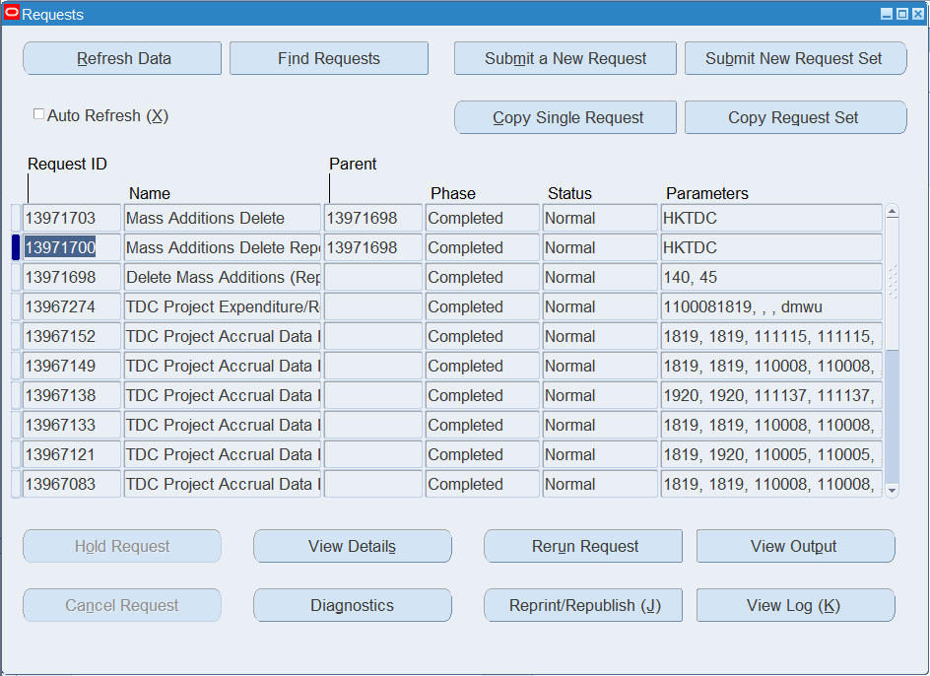
Asset Additions
Delete Mass Additions (4/5)
Click “Refresh Data” until the Mass Additions Delete request completes normally.
Select the Mass Additions Delete Report.
Click “View Output”
9
10
11

Slide 57

Asset Additions
Delete Mass Additions (5/5)
The mass addition lines deleted will be shown for review.

Slide 58
Asset Additions
Print Asset Barcode

Slide 59
Asset Additions
Print Asset Barcode (1/4)
Responsibility:
TDC Fixed Asset Operator/
TDC Fixed Asset Superuser
Choose “Requests” function.
(Menu) View > Requests
Click “Submit a New Request.
1
2

Slide 60

Asset Additions
Print Asset Barcode (2/4)
Choose the “TDC Asset Barcode Printing”
Select the Asset Number range for which barcodes should be generated.
Select the Serial Number range for which barcodes should be generated. Assets without serial numbers will always be included regardless of the serial number range.
Optionally further limit the assets included by selecting a range of Date Placed in Service.
Click “OK”.
Click “Submit”.
3
4
5
6
7
8

Slide 61

Asset Additions
Print Asset Barcode (3/4)
Click “No” for only submitting this request.
Click “Find”.
9
10

Slide 62

Asset Additions
Print Asset Barcode (4/4)
11
Click “Refresh Data” until the “TDC Asset Barcode Printing” request completes normally.
Select the Mass Additions Create Report.
Click “View Output”.
12
13

Slide 63
Month End Process
Run Depreciation

Slide 64

Month End Process
Run Depreciation (1/4)
Responsibility:
TDC Fixed Asset Superuser
FA - (N) > Depreciation > Run Depreciation.
1

Slide 65

Month End Process
Run Depreciation (2/4)
Select the “HKTDC” Book.
Select the Close Period checkbox to close the current FA period and open the next period.
Click “Run”.
Note: FA period CANNOT be re-opened once closed. AP period should be closed before FA.
2
3
4

Slide 66
Month End Process
Run Depreciation (3/4)
Choose “Requests” function. (Menu) View > Requests
Click “Find”.
5
6

Slide 67

Month End Process
Run Depreciation (4/4)
Click “Refresh Data” until the all requests complete normally.
Select the “Journal Entry Reserve Ledger Report”.
Click “View Output” to open a report showing the depreciation expense calculated for each asset.
7
8
9

Slide 68
Month End Process
Create Accounting

Slide 69
Month End Process
Create Accounting (1/3)
Responsibility:
TDC Fixed Asset Superuser
Choose “Requests” function. (Menu) View > Requests
Click “Submit a New Request”.
1
2

Slide 70

Month End Process
Create Accounting (2/3)
Select the “Create Accounting – Assets” request.
Fill in the parameters (refer to the next slide for details).
Click “OK”.
Click “Submit”
3
4
5
6

Slide 71
Month End Process
Parameter | Description
Book Type Code (for FA only) | Asset Book Value. The Asset Book to be processed.
Ledger | The GL Ledger that journals will be transferred to
Process Category | Event Category that want to be specified such as Additions, Adjustment
End Date | The accounting event before the selected date will be selected into current batch
Accounting Mode | Draft or Final. Draft mode act as a preliminary run of the create accounting and would NOT transfer journals to GL while Final will create journals.
Error Only | If ‘Y’ is chose, only the journal creation error out in last run will be processed
Report | Detail, Summary or No Report. It control the create account report layout.
Transfer to General Ledger | If Yes, journals created will transfer to GL. Otherwise, it will park in Subledger and wait for the Transfer to GL concurrent program to transfer it to GL.
Post in General Ledger | If Yes, posting will be submitted in GL after the journals transferred to GL.
General Ledger Batch Name | The journal batch name will include this value as prefix of journal batch name.
Inventory Organization | The Inventory Organization to be processed
Include User Transaction Identifiers | If Yes, Asset Number will be provided in Create Accounting Report which will facilitate user to troubleshoot create accounting issue.

Slide 72


Month End Process
Create Accounting (2/3)
Click “Find”.
Click “Refresh Data” until all request complete normally.
Select “Create Accounting – Assets” and
Click “View Output” to review the journal entries generated.
8
9
7
10

Slide 73

Q&A
Oracle EPM Implementation Proposal
73

Slide 74
About Deloitte Global Deloitte refers to one or more of Deloitte Touche Tohmatsu Limited, a UK private company limited by guarantee (“DTTL”), its network of member firms, and their related entities. DTTL and each of its member firms are legally separate and independent entities. DTTL (also referred to as “Deloitte Global”) does not provide services to clients. Please see www.deloitte.com/about to learn more about our global network of member firms.
Deloitte provides audit & assurance, consulting, financial advisory, risk advisory, tax and related services to public and private clients spanning multiple industries. Deloitte serves over 80 percent of the Fortune Global 500® companies through a globally connected network of member firms in more than 150 countries and territories bringing world-class capabilities, insights, and high-quality service to address clients’ most complex business challenges. To learn more about how Deloitte’s approximately 286,000 professionals make an impact that matters, please connect with us on Facebook, LinkedIn, or Twitter.
About Deloitte China The Deloitte brand first came to China in 1917 when a Deloitte office was opened in Shanghai. Now the Deloitte China network of firms, backed by the global Deloitte network, deliver a full range of audit & assurance, consulting, financial advisory, risk advisory and tax services to local, multinational and growth enterprise clients in China. We have considerable experience in China and have been a significant contributor to the development of China's accounting standards, taxation system and local professional accountants. To learn more about how Deloitte makes an impact that matters in the China marketplace, please connect with our Deloitte China social media platforms via www2.deloitte.com/cn/en/social-media.
This communication contains general information only, and none of Deloitte Touche Tohmatsu Limited, its member firms, or their related entities (collectively the “Deloitte Network”) is by means of this communication, rendering professional advice or services. Before making any decision or taking any action that may affect your finances or your business, you should consult a qualified professional adviser. No entity in the Deloitte Network shall be responsible for any loss whatsoever sustained by any person who relies on this communication.
© 2020. For information, contact Deloitte China.

